Slide 1
The Cellular Concept-
System Design Fundamentals
(Continued)

Slide 2
Trunking
The Telephone Company uses trunking theory to determine the number of channels needed to be allocated for hundreds of users
Each user is allocated a channel on a per call basis and upon termination of the call, the occupied channel immediately returns to the available pool of channels
When a user requests to call, but all the channels are busy, then the user will be blocked or delayed.

Slide 3
Erlang
The fundamentals of trunking theory was developed by a Danish mathematician Erlang.
Today the measure of traffic intensity bears his name
One Erlang represents the amount of traffic intensity carried by a fully occupied channel during a fixed time.
For example, if one channel is busy during 30 minutes within a hour, then it is said that the traffic intensity is .5 Erlang

Slide 4
Grade of Service (GOS)
Grade of Service (GOS) is a measure of congestion which is specified as the probability of a call being blocked (Erland B) or a call being delayed for a certain amount of time (Erlang C)
GOS of 2% blocking means that the channel allocation is designed in such a way that 2 out of 100 calls will be blocked due to channel occupancy during the busiest hour.

Slide 5
Terminologies
Set up time
  The time required to allocate a trunked radio channel to a user
Blocked call
  A call that cannot be completed due to congestion
Load
  Traffic intensity over the entire trunked radio system

Slide 6
Terminologies
Traffic intensity
  Measure of channel time utilization. It is the average channel occupancy measured in Erlangs.
  Denoted by A (dimensionless)
Request rate
  The average number of call requests per unit time, denoted by λ (sec⁻¹)
Holding time
  Average duration of a call, denoted by H (sec)

Slide 7
Equations
The traffic intensity offered by each user is given by
A_{u} = λH
where H is the average duration of a call and λ is the average number of call requests per unit time for a user.
A system containing U users, the total traffic intensity is given by A = UA_{u}
In a C channel trunked system, the traffic intensity per channel is given by A_{c} = UA_{u} / C

Slide 8
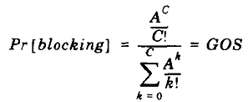
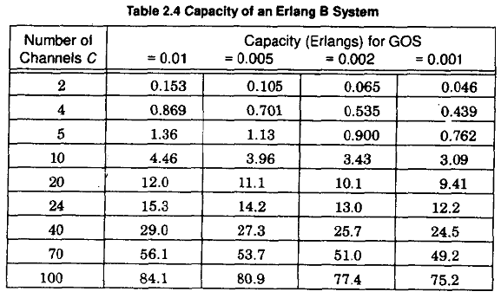
Erlang B formula
The Erlang B formula determines blocking probability of a call

Slide 9
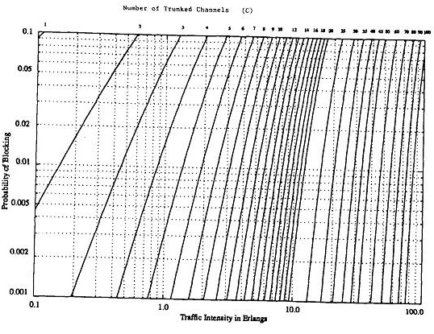

Slide 10
Trunking Efficiency
Trunking efficiency is a measure of the number of users which can be offered a particular GOS with a particular configuration of fixed channels.
The way in which channels area grouped can substantially alter the number of users handled by a trunked system.
For example, 10 channels at 1% blocking can support 4.46 Erl of traffic whereas, 2 groups of 5 channels can support 2 x 1.36 Erl = 2.72 Erl.
Hence, allocation of channel groups has a major impact on overall system capacity.

Slide 11
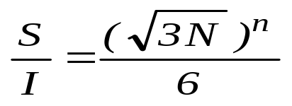
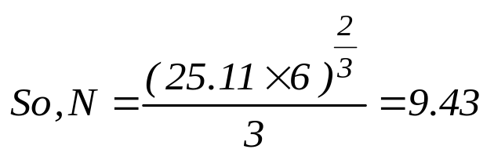
Example #1
An operator has a total of 48 carrier frequencies in use and SIR requirement for the system is 14 dB. Suppose the propagation exponent for the area is n = 3. How many frequencies can be used per cell (frequency reuse factor) ?
We know SIR equals .
Given, SIR = 14 dB = 10^{14/10} = 25.11
The nearest possible value for N is 12. Therefore the required cluster size N has to be 12.
This means that 48/12 = 4 carrier frequencies can be used in each cell.

Slide 12
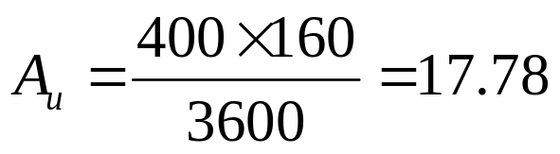
Example #2
The maximum calls per hour in a mobile cell equals 400 and the average call holding time is 160 seconds. If the GoS is 2%, ﬁnd the offered load A. How many service channels are required to handle the load?
Traffic intensity,
Using the Erlang B chart 25 channels give 18 Erlangs of traffic intensity at 2% blocking. So we need 25 service channels

Slide 13
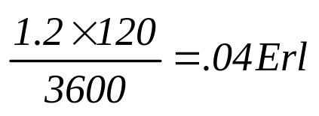
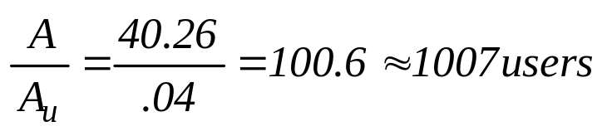
Example #3
How many mobile subscribers can be supported with 50 service channels at 2% GoS? Assume the average call holding time equals 120 seconds and the average busy hour call per subscriber is 1.2 calls per hour.
From the Erlang B chart, for 50 channels at 2% blocking,
the offered load is 40.26 Erlangs.
Average Traffic per channel, A_{u} =
Number of users, U =

Slide 14
Coverage VS Capacity
Maximizing coverage
Use low frequency band
Increase antenna height
Maximize transmission power
Reduce quality requirements
Maximizing capacity
Maximize frequency band
Reduce antenna height
Reduce C/I requirements
Re-use frequencies

Slide 15
Improvement Techniques
All the cells are different
  No. of subscribers, path loss, geography, usage statistics etc
Cannot have one-and-for-all design
  Require special techniques/schemes for different cells
Also, the number of subscribers can grow
  Don’t want to redesign the entire system
Improvement techniques
  Cell Splitting
  Sectoring
  Repeaters

Slide 16
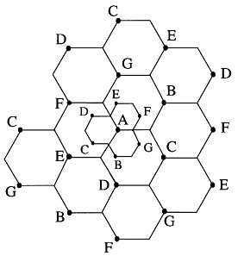
Cell Splitting
In highly congested cell, there are many subscribers in a cell
  Not enough channels to support the desired GOS
Subdivide a congested cell into smaller cells (microcells)
  Increases the system capacity by
  reusing the frequency channels more
  Reduce the number of subscribers per
cell such that the traffic generated is
under the maximum provided
  Need to reduce the transmit power
accordingly to maintain the SIR

Slide 17
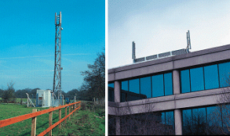
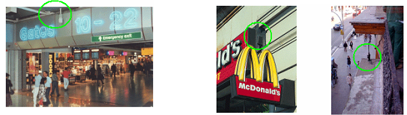
Cell Splitting (cont’d)
Advantages
  Increase system capacity
  Reduce transmission power
Disadvantages
  More base station Macro Cell
  More handoff traffic
  Pico Cell Micro Cell

Slide 18
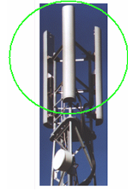
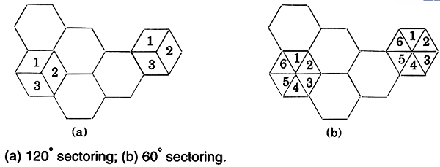
Sectoring
Use of directional antenna to divide cells to sectors
  Normally partitioned into 3 120° sectors or 6 60° sectors
  Co-channel cells drop from 6 to 2 for 120° sectors or 1 for 60° sectors
  Divide the channels in 1 cell evenly among the sectors

Slide 19
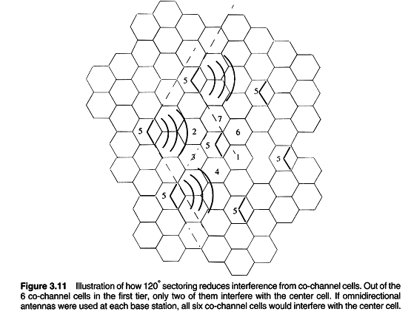
Sectoring (cont’d)

Slide 20
Sectoring (cont’d)
Advantages
  Increase system capacity
    As SIR increased ⇒ so we can reduce cluster size (N ↓) ⇒ more frequencies can be reused (M ↑) ⇒ increase system capacity (C_{sys}↑)
Disadvantages
  Loss of trunking efficiency
    Channels are divided into sectors.
    Less trunked channels ⇒ less max system traffic
  More handoffs
    BS can handle handoff between sectors, without MSC computation
    Better with DCA (Dynamic Channel Allocation) because no handoff required between sectors

Slide 21
Repeater
For use in hard-to-reach areas, such as buildings, tunnels
Often used with distributed antenna system
  A number of antennas are distributed in different spots to transmit the same signal and for reception
Downlink / Forward Link
  Receive signal from “outside”, amplify and retransmit “inside”
Uplink / Reverse Link
  Receive signal from “inside”, amplify and retransmit “outside”
No increase in capacity!!!!

Slide 22
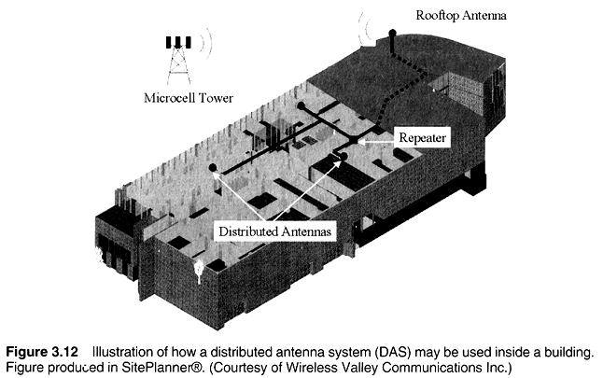
Repeater (cont’d)

Slide 23
Summary
Cellular concept is the core of mobile communication
  Frequency reuse
  Channel assignment schemes
  Handoff
Good system design is very important
  High system capacity
  Good GOS with trunking
  Low transmission power
System improvement techniques
  Cell splitting
  Sectoring
  Repeaters

Slide 24
Reference
Wireless Communications: Principles and Practice – Theodore S. Rappaport
  E-Book, 1st Edition – Section 2.6 - 2.7.2, Page 44 - 60
  Paper book, 2nd Edition – Section 3.6 - 3.7.3 Page 77 - 93

